Slide 1

CLOUD COMPUTING WITH AZURE

Slide 2
CLOUD COMPUTING
Cloud computing is the supply of computer services over the Internet, including servers, storage, databases, networking, software, analytics, and intelligence. This allows for speedier innovation, adaptable resources, and scale economies.

Slide 3
CATEGORIES OF CLOUD COMPUTING
IaaS
PaaS
SaaS
IaaS stands for
Infrastructure as a Service.
IaaS provides virtualized computing resources over the internet. Users can rent virtual machines, storage, and networking components on which they can deploy their own software and applications.
PaaS stands for Platform as a Service
PaaS offers a platform that includes not only infrastructure but also development tools and services for building, testing, and deploying applications.
SaaS stands for Software as a Service
SaaS delivers complete software applications over the internet on a subscription basis. Users can access these applications through web browsers, eliminating the need for installation and maintenance.

Slide 4

What is Azure?
Microsoft Azure is a cloud computing platform and service that supports their clients by providing computing power and many other web services.

Slide 5
Azure Services
Virtual Machines (VMs):Azure allows users to create and manage virtual machines running various operating systems, providing flexibility and scalability.
Azure App Services: This service enables the easy deployment and scaling of web applications and APIs.
Azure Storage: Offers various storage solutions like blob storage, file storage, and table storage for data storage needs.
Azure IoT: Provides tools and services for building and managing Internet of Things (IoT) applications and devices.
Azure AI: A dedicated service within Azure for deploying artificial intelligence solutions.

Slide 6
Points To Highlight
Azure operates in multiple regions around the world, allowing users to deploy resources and services closer to their target audience for reduced latency and improved performance.
It also contains a vast ecosystem of pre-built solutions and services that users can quickly deploy, reducing development time and effort.
Azure Cost Management and Billing tools help users track and manage cloud spending.
Azure provides elastic scalability, enabling users to easily scale their resources up or down to meet changing demands.

Slide 7
Pricing
Azure offers a limited-time free trial with a specific amount of credits, allowing users to explore and try out various services at no cost. After the trial period or when the credits are exhausted, you will start incurring charges based on usage. It also provides an online pricing calculator that allows users to estimate the costs of Azure services based on their specific requirements before they start using them.
Microsoft offers three main ways to pay for Azure VMs and other cloud resources: pay as you go, reserved instances, and spot pricing

Slide 8
Pricing Models
Pay as you go
Reserved Instances
Spot Pricing
You can pay for
services on Azure
according to actual
usage, billed per
second, with no long
term commitment or
upfront payments.
Azure provides
Reserved
Virtual Machine
Instances (RVMI)
virtual machines that
are pre-purchased for
one or three years in a
specific region.
You can buy unused
computing power at a
discount of up to 90%
compared to pay as you
go prices. However,
spot instances can be
interrupted on short
notice, so they are
suitable only for
workloads that can
tolerate disruptions.

Slide 9


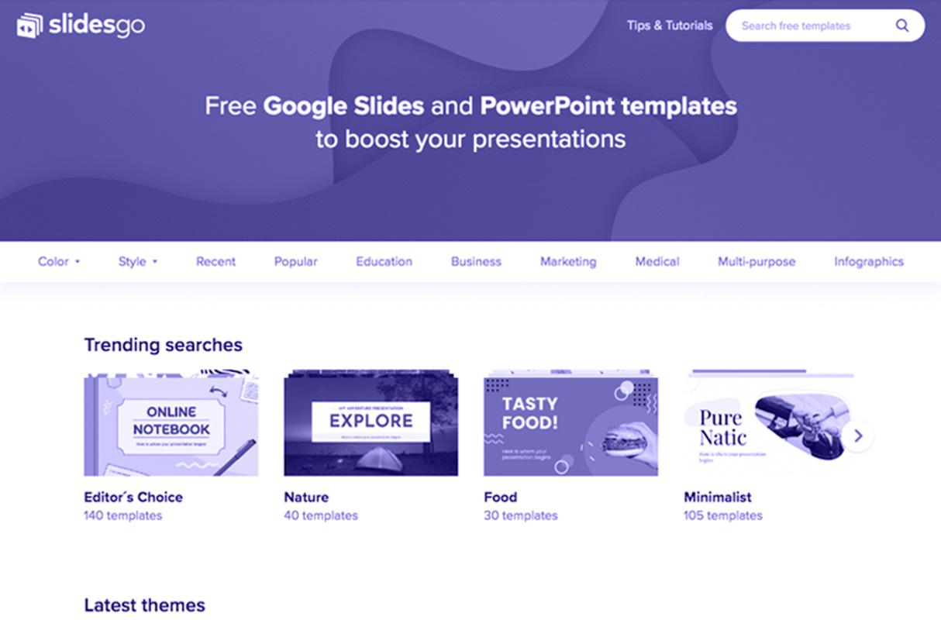
Stay Connected
Do follow our Socials:
Website: vitchennai.acm.org
Linkedin: ACM VITC
Instagram: acm_vitcc

Slide 10
THANKS!

